Slide 1





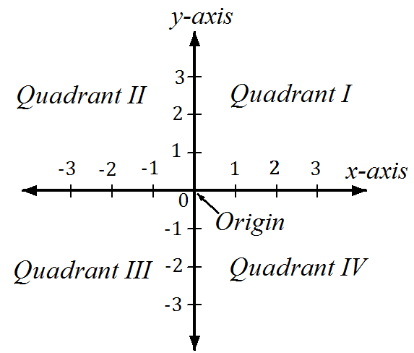


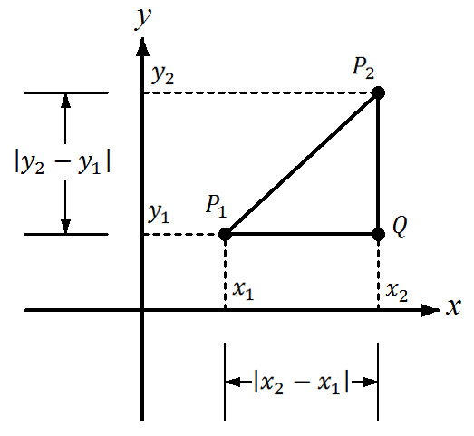
University of Diyala / College of Eng. Civil Engineering Department.
Class: 1st year /Mathematics I
The Cartesian plane is formed by
using two real number lines intersecting at right angles, as shown in Figure. The horizontal real number
line is usually called the x-axis, and the vertical real number line is usually called the y-axis. The point of intersection of these two axes is the
origin, and the two axes divide the plane into four parts called quadrants .
Each point in the plane corresponds to an ordered pair (x, y) of real numbers and called the coordinates of the point.
The distance formula is derived by using
the Pythagorean Theorem. From the Figure:
P₁Q = x₂-x₁ , QP₂ = y₂-y₁
P₁P₂ ²= x₂-x₁ ²+ y -y ²
2 1
P₁P₂ ²= x₂-x₁ ²+ y -y ²
2 1
The distance d between the points x₁,y₁ and x₂,y₂ in the coordinate plane is
d= x₂-x₁ ²+ y -y ²
2 1
1

Slide 2






University of Diyala / College of Eng. Civil Engineering Department.
Class: 1st year /Mathematics I
The midpoint of the line segment joining the points in the coordinate
plane is
Midpoint= ^{x1+x2} , ^{y1+y2} where x = ^{x1+x2} , y= ^{y1+y2} 2 2 2 2
 /Find (a) the distance between and (b) the midpoint the line segment joining, the points (-2,1) and (3,4).
/
2 2 ² 2
(a) d= x₂-x₁ + y₂-y₁ = 3- -2 + 4-1 = 25+9= 34
(b) Midpoint= ^{x1+x2} , ^{y1+y2} = ⁻²⁺³ , ¹⁺⁴ = ¹ , ⁵
2 2 2 2 2 2
 /Use distance formula to show that the points A(1,1) ,
B(5,1) ,and C(5,7) are represent the vertices of right- angled triangle, then find the area of triangle.
/
AB= 5-1 ²+ 1-1 ²= 4 ²+ 0 ²= 16=4
BC= 5-5 ²+ 7-1 ²= 0 ²+ 6 ²= 36=6
2 2
CA= 5-1 + 7-1 == 4 ²+ 6 ²= 52
CA ²= AB ²+ AB ² ⇒ ⇒ 52 ² = 4 ² + 6 ² ⇒ ⇒52=52
A= ¹ base height = ¹ 4 6 =12
2 2
2

Slide 3





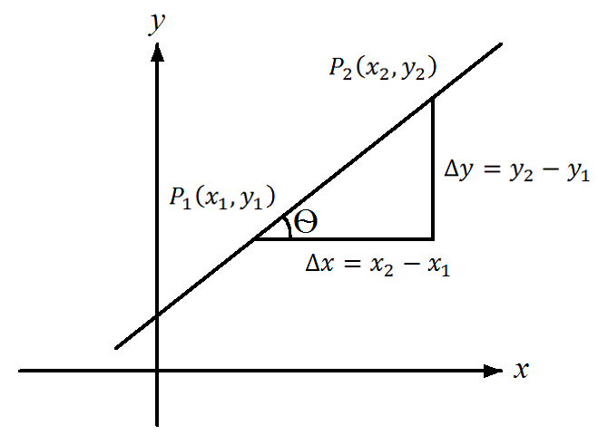





University of Diyala / College of Eng. Civil Engineering Department.
Class: 1st year /Mathematics I
An equation of the line passing through the point (x₁,y₁) and having
sloped m.
y-y₁=m(x-x₁)
Therefore we need a point (x₁,y₁) and the slope m.
m= tan θ
∆x
y -y
m= =
2 1
∆y x₂-x₁
❶ A horizontal line has slope zero because ∆y = 0 .
❷ The slope of a vertical line is undefined because ∆x = 0.
 /Find an equation of the line passing through the point (2,1) and having slope m=-1/2.
/
y-y₁=m(x-x₁)⇒⇒ y-1=- ¹ (x-2)⇒⇒ y=- ¹ x+2
2
of the line
2
passing
 /Find
an equation
through the
points (-1,-2) and(2,3) .
/
_{m=} 3- -2 ₌ 5 2- -1 3
3

Slide 4













University of Diyala / College of Eng. Civil Engineering Department.
Class: 1st year /Mathematics I
With m= ⁵ and (-1,-2)
3
5
y-y₁=m(x-x₁)⇒ ⇒ y- -2 = ₃ (x- -1 )
⇒+2y= ⁵ x+ ⁵ ⇒
⇒= ⁵y x+ ⁵ -2
3 3
3 3
A non vertical line crosses the y-axis at some point (0,b ) . The
number is called the y-intercept of the line
y-b=m(x-0) y=m x + b
Which is called the slope-intercept form of an equation of a line.
 / Find an equation of the line with slope m=3/4 and y- intercept 4.
/
y= m x +b
With m= ³ and b=4⇒= ³y x+4
4 4
An equation of the form
Ax +By +C=0
Where A,B , and C are constants and A and B are not both zero, is called a first-degree equation in x and y.
: We can find the slope by comparing the given equation with equation of intercept line y= mx +b .
Or from m= ^{-A}
B
4

Slide 5






University of Diyala / College of Eng. Civil Engineering Department.
Class: 1st year /Mathematics I
 / Find the slope of the line with equation 2x+3y+5=0.
/
3y=-2x-5⇒⇒ y= ⁻² x- ⁵ ⟺y=mx+b
3 3
The slope of the line m=- ² and y-intercept b=- ⁵ OR m= ^{-A} = ⁻²
3 3 B 3
Two lines L₁ and L₂with slopes m₁ and m₂, respectively,
For parallel lines m₁= m₂ For perpendicular lines m₁=- ¹
m₂
 / Find an equation of the line that passes through the
point (6,7) and is perpendicular to the line with equation 2x+3y=12. Solution /
3y=-2x+12 ⇒ y⟹= ⁻² x+4⇒ = my x +b
3
The slope of the line m₂=- ² ⇒m₁=- ¹ =- ¹ = ³
3 m₂
₋ 2 2
3
y-y =m(x-x )
₁ ⇒⇒ y-7= ³ (x-6)
⇒⇒ y-7= ³ x-9
1
2
2
⇒y= ³ x-2
2
5

